Slide 1
Module 7 Class Problems
Wind Power

Slide 2
Q1. The following wind measurements by bin are given for a proposed wind turbine location. Assume the air has a density of 1.15 kg/m3.
Bin | Wind speed (m/s) |  | hours/yr
 | min | max
1 | 0.0 | 0.0 | 80
2 | 0.0 | 1.0 | 200
3 | 1.0 | 2.0 | 501
4 | 2.0 | 3.1 | 850
5 | 3.1 | 4.1 | 1300
6 | 4.1 | 5.2 | 1407
7 | 5.2 | 6.2 | 1351
8 | 6.2 | 7.2 | 990
9 | 7.2 | 8.2 | 641
10 | 8.2 | 9.3 | 480
11 | 9.3 | 10.3 | 375
12 | 10.3 | 11.3 | 291
13 | 11.3 | 12.3 | 180
14 | 12.3 | 13.4 | 78
15 | 13.4 | 14.4 | 32
16 | 14.4 | unbounded | 4
Determine average wind velocity, u_{mean}, for this location
Calculate the total estimated energy available in the wind from the bin data, in kWh/m². For bin 16, assume an average wind speed of 16 m/s.
Calculate the estimated energy available in the wind using the average wind speed and the Rayleigh function. For bin 16, assume an average wind speed of 16 m/s.

Slide 3
Q2. A 27-mph wind at 14.7 psia and a temperature of 70ºF enters a three-bladed HAWT wind turbine with a diameter of 36 ft. Calculate (a) the power of the incoming wind, (b) the theoretical maximum power that could be extracted, (c) a reasonable value for attainable power, (d) the rotor speed, in RPM, required for part (c)

Slide 4
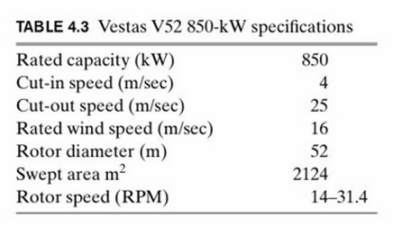
Q3. What is the power coefficient for the Vestas V52-850 kW wind turbine at rated conditions?

Slide 5
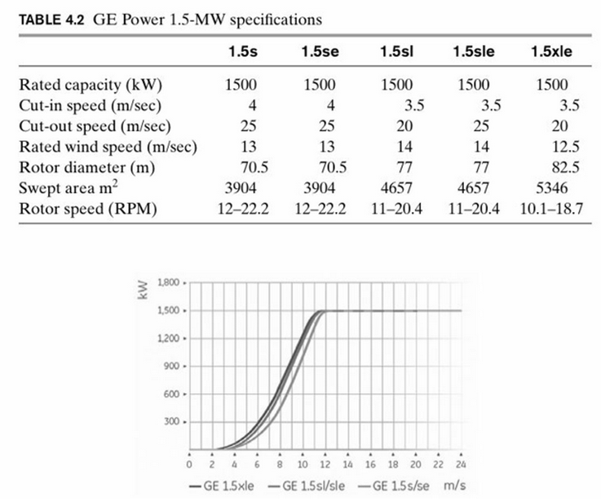
Q4. For a General Electric 1.5se wind turbine. Given the operating strategy to maximize the power to the rated capacity,
Estimate the power coefficient at the rated speed. Determine and plot Cp vs wind speed.
Estimate the yearly kWh production assuming a Rayleigh wind distribution average velocity of 8.862 m/s. Assume bin speeds of 1 m/s
Determine the capacity factor of the turbine

Slide 6
Q5. A wind turbine rated at 250 kW costs $450,000 and has a swept area of 1200 m². It is installed in a location with year-round average power density available in the wind of 320 W/ m², and on average converts 25% of the energy into electricity. The electricity is sold to the grid at $0.039/kWh, paid at the location of the turbine (i.e., no transmission cost). The project has a 20-year time horizon with salvage value of $20 thousand, and the MARR is 8%. Calculate the net present value (NPV) of this investment.

